Slide 1


Microprocessor……..

Slide 2
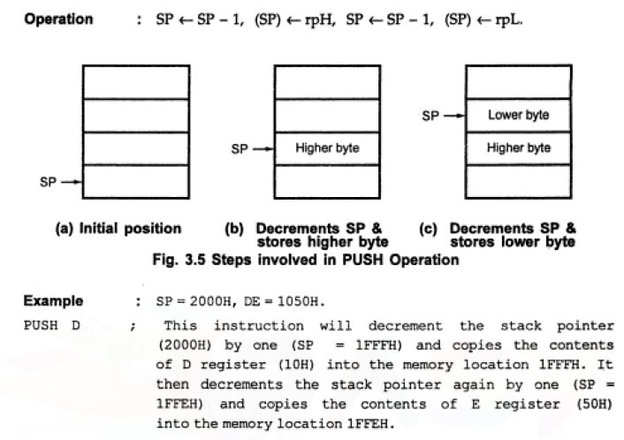
Microprocessor……..

Slide 3
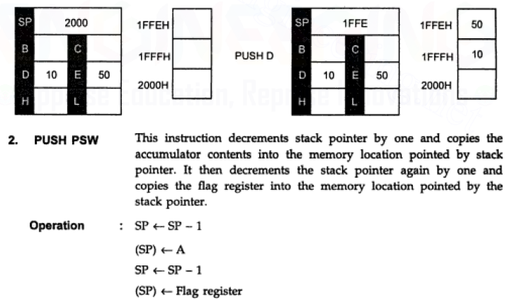
Microprocessor……..

Slide 4
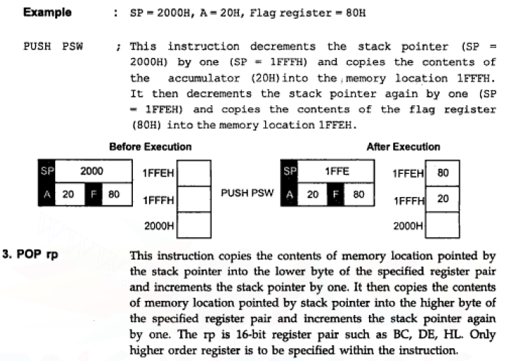
Microprocessor……..

Slide 5
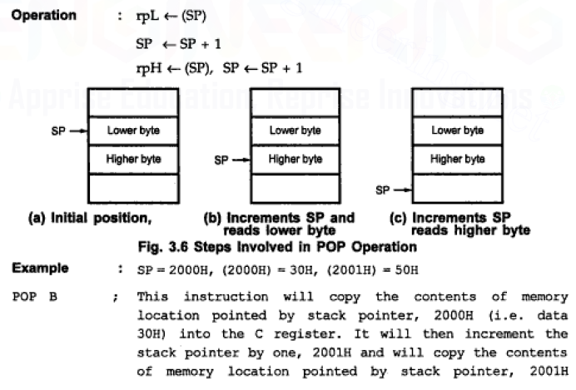
Microprocessor……..

Slide 6
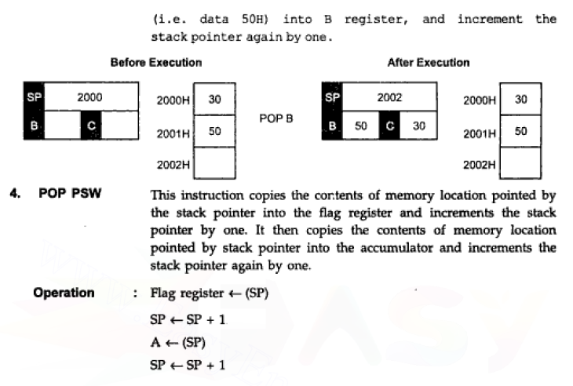
Microprocessor……..

Slide 7
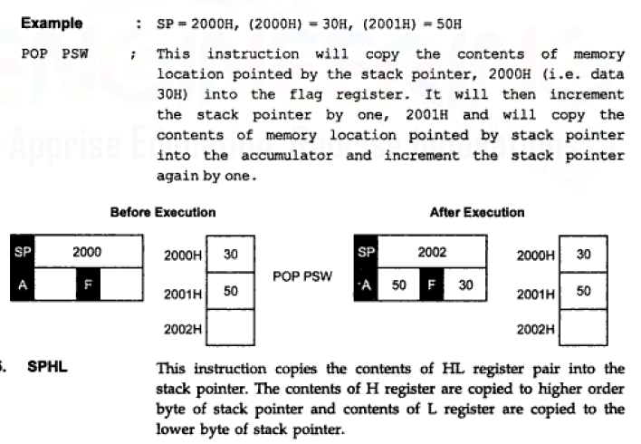
Microprocessor……..

Slide 8
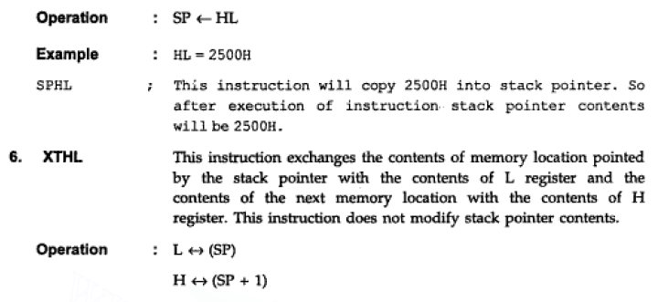
Microprocessor……..

Slide 9
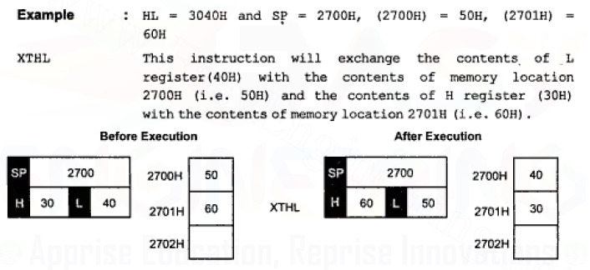
Microprocessor……..

Slide 10
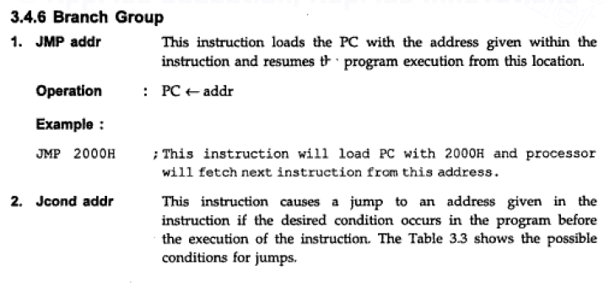
Microprocessor……..

Slide 11
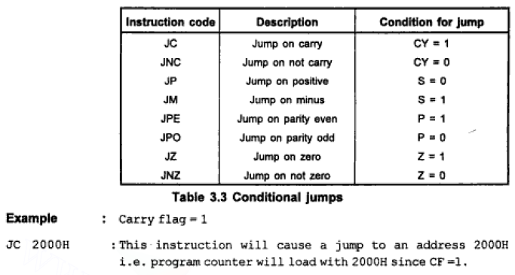
Microprocessor……..

Slide 12
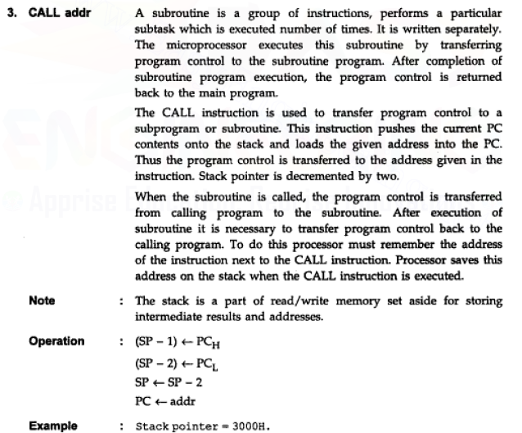
Microprocessor……..

Slide 13
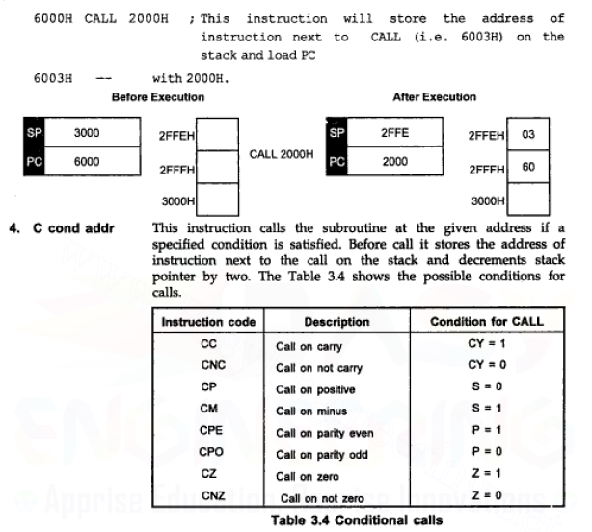
Microprocessor……..

Slide 14
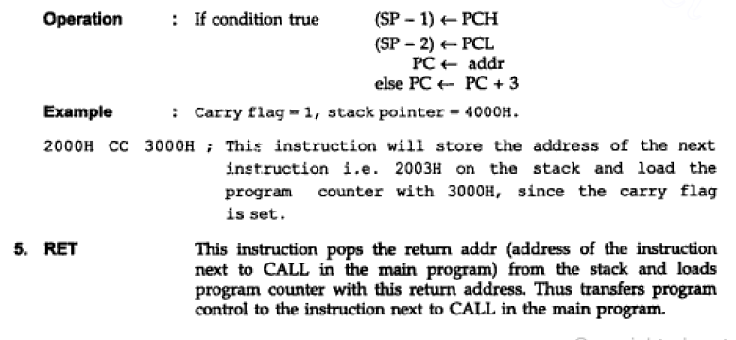
Microprocessor……..

Slide 15
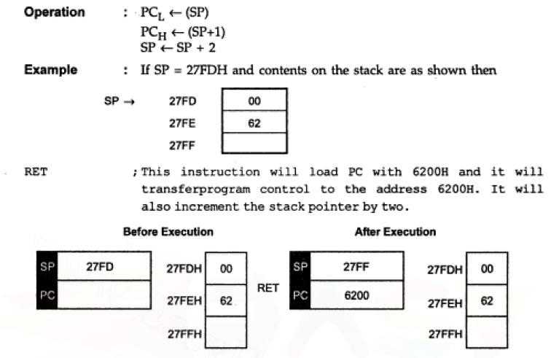
Microprocessor……..

Slide 16
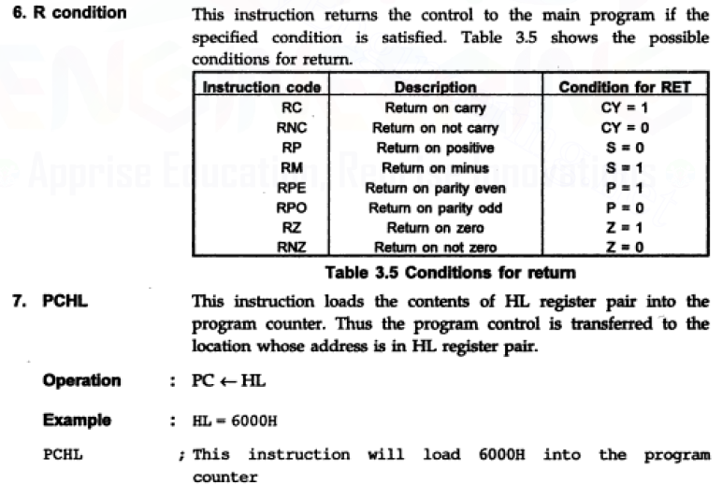
Microprocessor……..

Slide 17
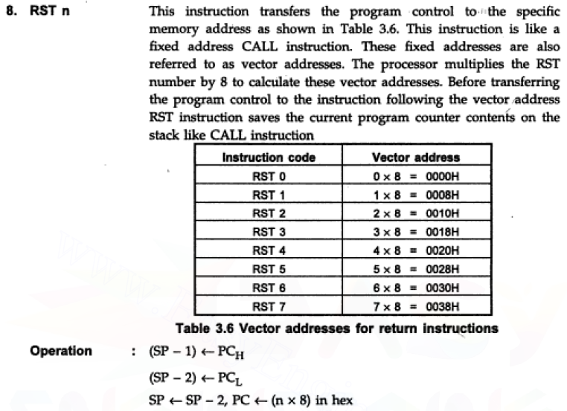
Microprocessor……..

Slide 18
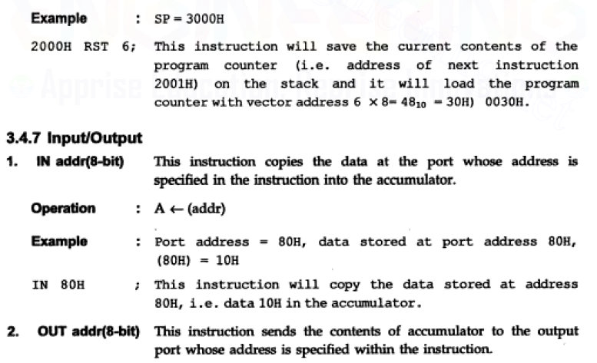
Microprocessor……..

Slide 19
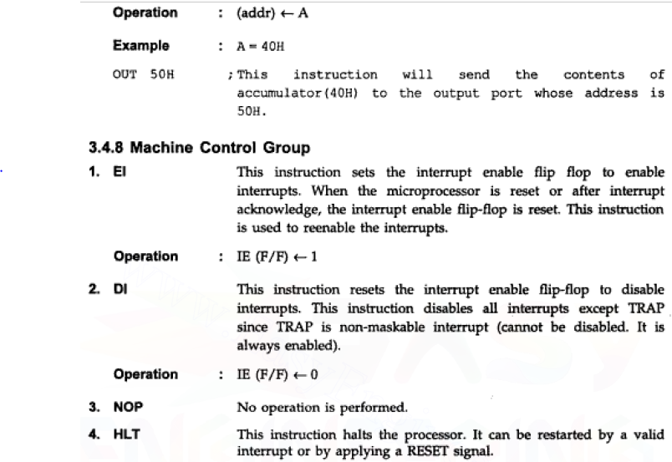
Microprocessor……..

